Slide 1

Documenting your Dynamics CRM in a day

Slide 2

Mitch Milam
Dynamics CRM Architect
Independent consultant and trainer
Ten-Time Dynamics CRM MVP
mitch@xrmcoaches.com
infinite–x.net
@mitchmilam

Slide 3
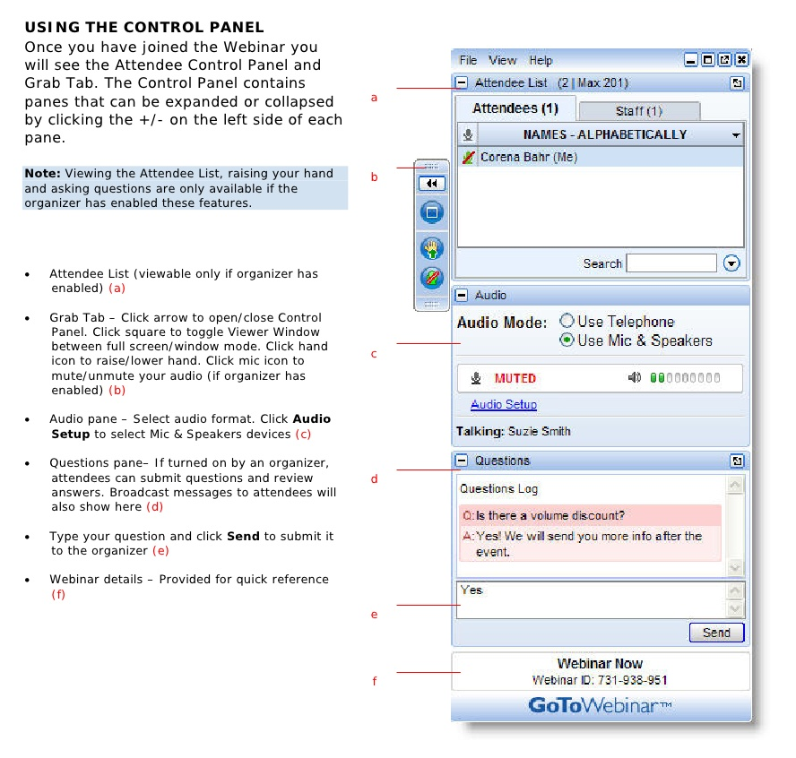
Webinar Housekeeping

Slide 4
Future Events
Webinar: Training Strategies to Increase Dynamics CRM User Adoption
Friday, Apr 29, 2016 10:00 AM – 11:00 AM CDT

Slide 5



2016 Training Roadmap
Webinars
http://www.xrmcoaches.com/webinars
KnowledgeBits
http://www.xrmcoaches.com/knowledgebits
Learning Plans
http://www.xrmcoaches.com/freestuff
More Goodies
Practice tests
On–Demand video training
Instructor–led training
Books

Slide 6
Agenda
Useful tools
Where the data is located
How to create reports

Slide 7
Tools

Slide 8
Building Your Toolbox
SnapShot! For Dynamics CRM
http://www.crmaccelerators.net/snapshot
XrmToolbox
http://www.xrmtoolbox.com
SnagIt
https://www.techsmith.com/snagit.html
FetchXmlBuilder
Script Finder

Slide 9
Data Access

Slide 10
Data Access Levels
Easy
Use Advanced Find
Challenging
Use the XrmToolbox
Difficult
Write a custom application
Perform a manual operation

Slide 11
Procedures

Slide 12
Customizations
SnapShot! (Demo)
Entities
Fields
Views
Forms
Relationships
Option Sets
User Charts
System Charts
Web Resources
Themes
Advanced Find
Plugin Assemblies
Plugin Steps (SDK Message Processing Steps)
Processes
XrmToolbox
Solutions

Slide 13
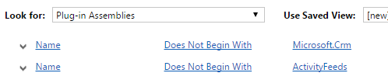
Plugin Assemblies

Slide 14
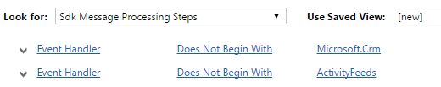
Plugin Steps

Slide 15
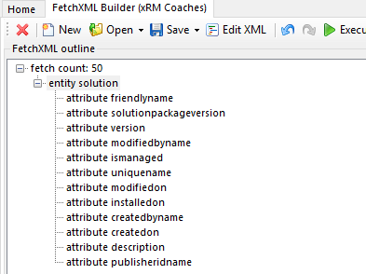
Solutions

Slide 16
Business Management
SnapShot! (demo)
Connection Roles
Templates
Advanced Find
Queues

Slide 17

Queues

Slide 18
Adminstration
XrmToolbox
System Settings
User Settings

Slide 19
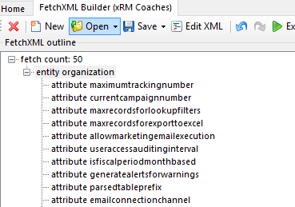
System Settings

Slide 20
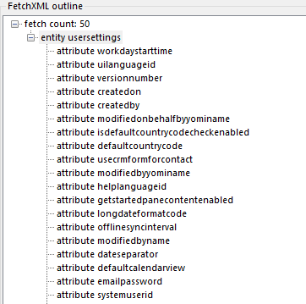
User Settings

Slide 21
Security
Advanced Find
Users
Teams
Security Roles
Business Units
Field Security Profiles
XrmToolbox
Access Team Templates
Positions
Security Role Privileges

Slide 22
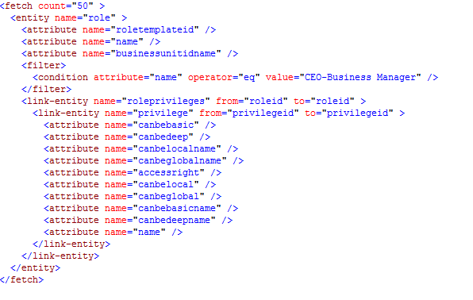
Security Role Privileges

Slide 23
Email Configuration
Advanced Find
Email Server Profiles
Mailboxes

Slide 24
User Interface Components
Manual Operation
Export Ribbon XML
Export SiteMap XML

Slide 25
JavaScript
XrmToolbox
List of JavaScript web resources (Script Finder)
Export JavaScript (Web Resources Manager)

Slide 26
Forms
SnagIt
Capture form layout

Slide 27
Processes
SnagIt
Capture process configuration

Slide 28
Demonstrations

Slide 29
Questions?

Slide 30
Thank You

